Slide 1
Neuro-Interactive Gaming: GO HACK
Leveraging EEG for Adaptive Gameplay

Slide 2
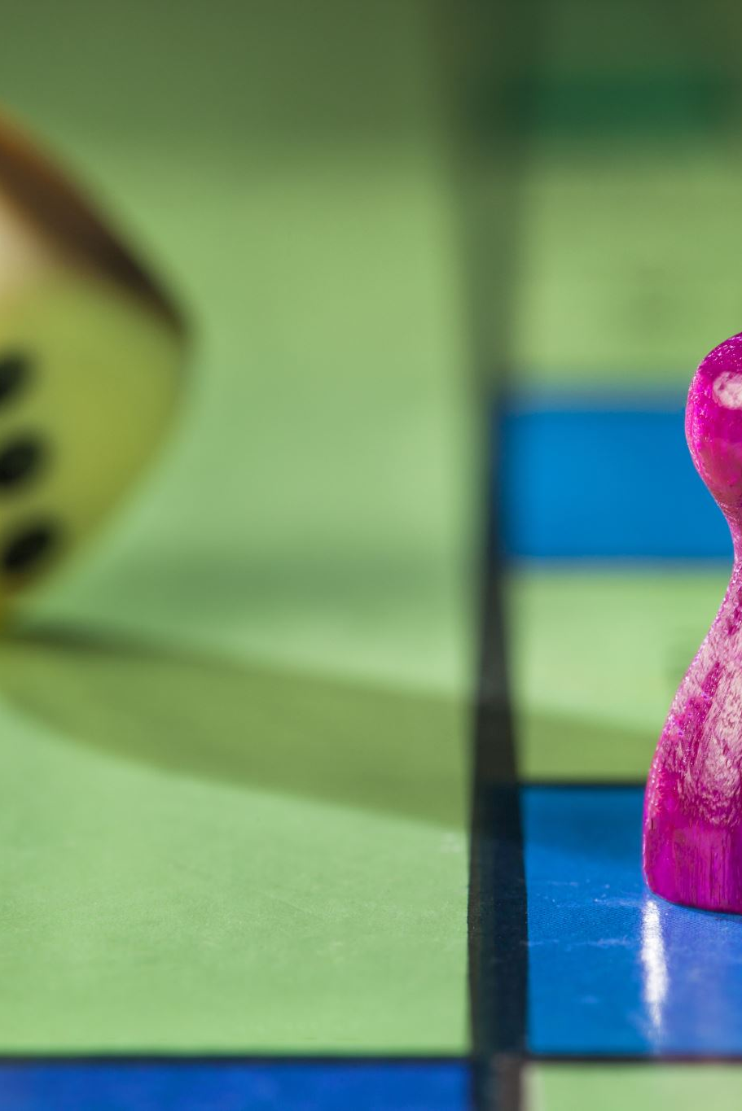
Problem Statement
- Stress negatively affects cognitive performance, leading to poor decision-making and reaction times in games.
- Traditional games do not account for the player's emotional state, making them less adaptive.
- Our goal: Develop a game where stress weakens the player’s performance, encouraging stress management.

Slide 3
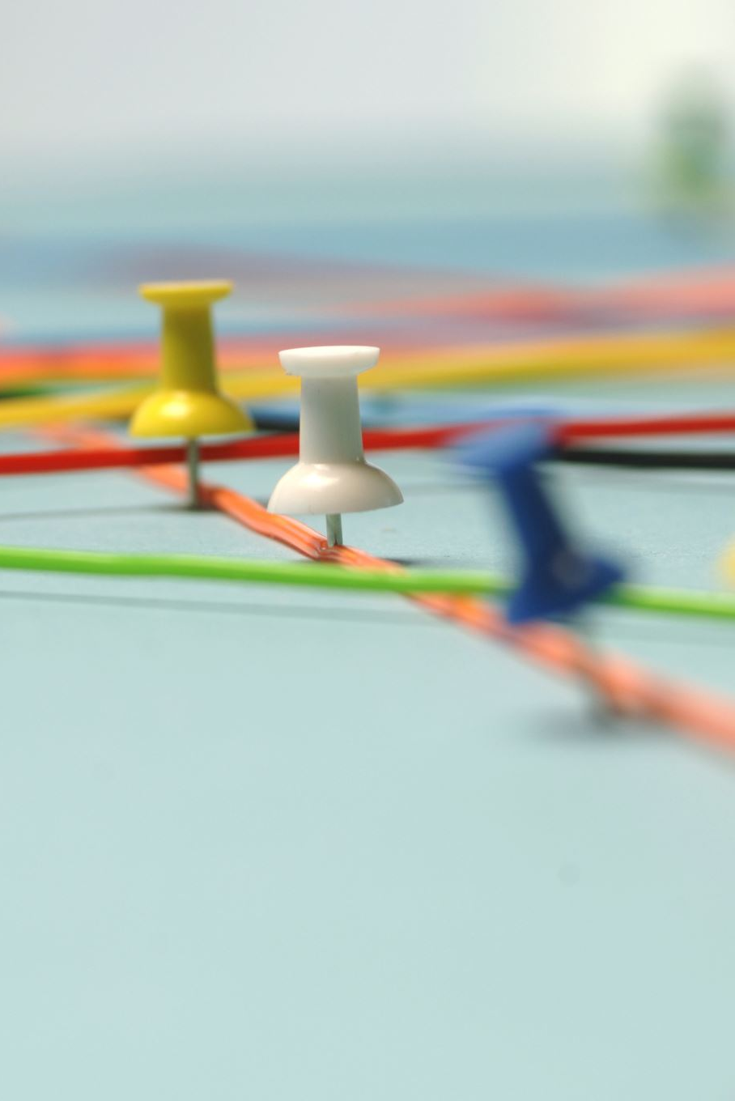
Solution Overview
- Our game integrates real-time EEG monitoring to assess stress levels.
- Players who stress too much will find their performance weakened .
- The game encourages players to remain calm to improve their chances of winning.
- This approach not only enhances gameplay but also trains users to manage stress effectively.

Slide 4
How It Works
- EEG sensors are worn by the player to capture real-time brainwave activity.
- The system monitors brainwaves, focusing on high beta waves .
- If stress levels exceed a certain threshold, the game reacts by making it harder for the player to succeed.
- Players must practice relaxation techniques (controlled breathing, mindfulness) to maintain peak performance.
- This creates a feedback loop where players learn stress management while gaming.

Slide 5
Data Pipeline
1. EEG Data Collection:
2. Signal Processing
3. Feature Extraction
4. Stress Level Mapping
5. Game Adaptation

Slide 6
How EEG Data is Being Manipulated
Step-by-step EEG Data Manipulation Process:
Raw EEG Signal Capture
EEG headsets/sensors record brainwave activity.
The signal contains noise (e.g., muscle movements, eye blinks) that must be filtered.
Preprocessing & Noise Reduction
Apply bandpass filters to isolate relevant brainwave frequencies.

Slide 7
How EEG Data is Being Manipulated
Feature Extraction: Identifying Stress Indicators
Focus on specific brainwave frequencies:
Delta (0.5–4 Hz) – Deep sleep, not relevant here.
Theta (4–8 Hz) – Relaxation, lower stress levels.
Alpha (8–13 Hz) – Calm, focused state.
Beta (13–30 Hz) – Higher stress levels, cognitive processing.
Gamma (30+ Hz) – High mental effort, can indicate problem-solving.
Key Stress Marker: An increase in high beta waves (20–30 Hz) signals stress.
Use thresholding to classify stress levels dynamically.
Attar ET. Review of electroencephalography signals approaches for mental stress assessment. Neurosciences (Riyadh). 2022 Oct;27(4):209-215. doi: 10.17712/nsj.2022.4.20220025. PMID: 36252972; PMCID: PMC9749579.

Slide 8
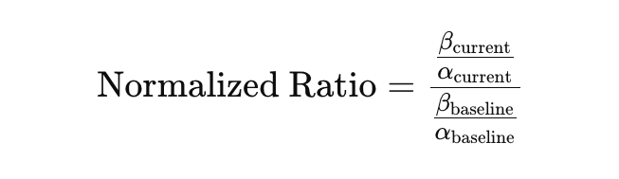
2. Levels of EEG Data Usage in the Game
EEG Stress Level | Player State | Game Adaptation
Low Stress (Alpha waves dominant, low Beta waves) | Player is calm | Normal game controls, smooth movement, invisibility , no additional obstacles.
Stress (High Beta waves, low Alpha waves) | Player is stressed | Visible and the enemy start chasing you

Slide 9
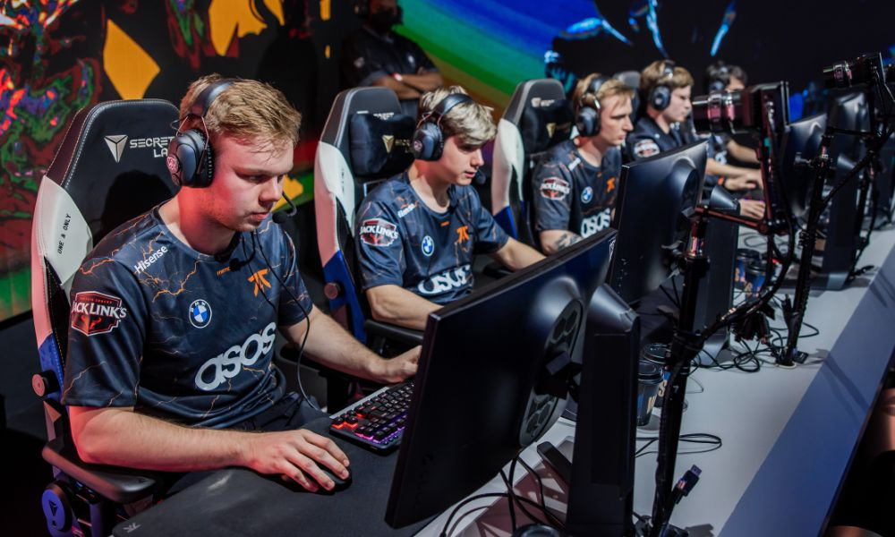
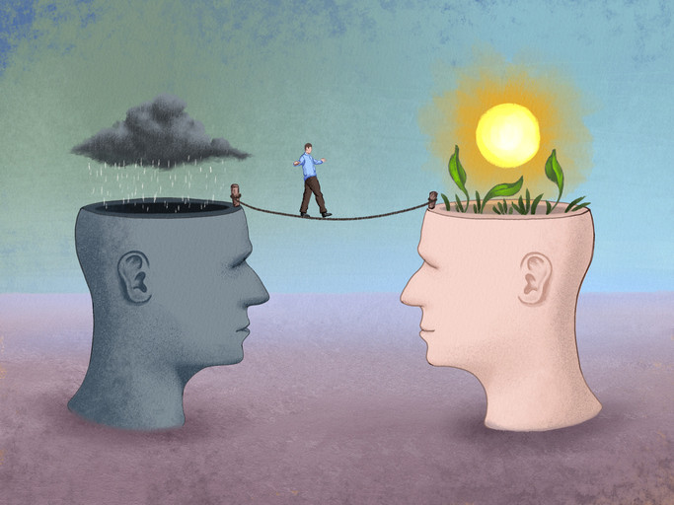


Potential Applications
Notes:
- Gaming & eSports: Helps professional gamers manage stress during high-stakes competitions.
- Cognitive Therapy: Can be used in therapeutic settings to train individuals with anxiety disorders.
- Mindfulness Training: Encourages players to develop relaxation techniques while playing.
-Workplace Stress Management: Could be adapted for employee stress training to improve productivity

Slide 10
Follow up
EEG-Based Therapy for Anxiety & PTSD Patients
Objective: Explore whether an EEG-driven game can help individuals with anxiety or PTSD learn emotional regulation techniques.
Method:
Work with therapists to introduce EEG-based gameplay as a therapeutic tool.
Patients with generalized anxiety disorder (GAD) or PTSD play a stress-adaptive game where they must stay calm to progress.
Measure changes in EEG stress markers and self-reported anxiety levels over multiple sessions.
Compare results with traditional therapy approaches.
Expected Outcome:
EEG-based games could be used as a complementary mental health tool to teach relaxation techniques in a non-intimidating, interactive way.

Slide 11
Follow up
Objective: Investigate whether stress-adaptive gaming can help professionals develop stress management skills in high-pressure jobs (e.g., finance, healthcare, emergency response).
Method:
Recruit participants from high-stress professions and have them play the game daily for 2 weeks.
Measure their EEG stress levels during gameplay and compare them to real-world stress markers (e.g., heart rate variability, self-reported stress).
Introduce different game mechanics:
Scenario 1: Game punishes stress (harder controls).
Scenario 2: Game rewards calmness (extra points for controlled breathing).
After 2 weeks, assess whether participants show reduced stress responses in real-life stress situations.
Expected Outcome:
If successful, this could be developed into corporate stress training programs to improve focus and resilience.

Slide 12
Follow up
Biofeedback Interventions to Reduce Stress During Gameplay
Objective: Test whether real-time biofeedback (like breathing exercises) can help players manage stress and improve gameplay performance.
Method:
When stress levels exceed a threshold (high beta waves detected), introduce in-game interventions such as:
Guided breathing exercises (e.g., a prompt to inhale for 4 seconds, exhale for 6 seconds).
Visual relaxation cues (e.g., screen brightness softens, music slows down).
Haptic feedback (controller vibrations for grounding techniques).
Measure changes in EEG stress markers before, during, and after intervention.
Expected Outcome:
Players who engage with biofeedback may reduce stress levels more effectively and perform better over time.

Slide 13
Conclusion
- Our neuro-interactive game introduces a new paradigm in gaming, where emotional state affects gameplay.
- By integrating EEG-based stress tracking, we encourage players to develop better stress management skills.
- This innovation has far-reaching applications in gaming, healthcare, mindfulness, and education.
- Bridging neuroscience and gaming, we aim to revolutionize interactive entertainment and mental well-being.

